Slide 1
ALGORITHMIC DISCRIMINATION AND THE LAW
Ashar Farooq

Slide 2
US Law
The Civil Rights Act of 1964/Others prohibits discrimination based on certain protected attributes, including, but not limited to, race, sex, religion, age for workers over 40 years old, national origin, and pregnancy.

Slide 3
The United States legal system distinguishes between intentional and unintentional discrimination. Disparate treatment refers to intentional discrimination based on certain protected attributes. This is in violation of civil rights legislations. Disparate impact refers to unintentional discrimination that results due to a certain unforeseen impact of a decision. This is deemed against the law unless the party can prove that such classification feature is necessary for the requirements and success of such party. The United States Supreme Court ruled in Griggs v. Duke Power Co. that pre-employment tests needed to be justified for the success and betterment of the job placement.

Slide 4
The Four-Fifths Rule, also known as the 80% Rule, states the presence of an adverse impact on a particular group if the rate of selection of this particular group is less than 80% than another group of higher rate of selection.

Slide 5
The city of New York recently assembled a task force to study possible biases in algorithmic decision systems. It released a report publicly that’s been criticized for not having any strong policy measures.

Slide 6
Algorithmic Accountability Act of 2019
Introduced by U.S. Senators Cory Booker (D-NJ) and Ron Wyden (D-OR), along with Rep. Yvette D. Clarke (D-NY) in April 2019
The Algorithmic Accountability Act would:
Authorize the Federal Trade Commission (FTC) to create regulations requiring companies under its jurisdiction to conduct impact assessments of highly sensitive automated decision systems. This requirement would apply both to new and existing systems.
Require companies to assess their use of automated decision systems, including training data, for impacts on accuracy, fairness, bias, discrimination, privacy and security.
Require companies to evaluate how their information systems protect the privacy and security of consumers' personal information.
Require companies to correct any issues they discover during the impact assessments.

Slide 7

Progress on Algorithmic Accountability Act of 2019

Slide 8
Consumer Online Privacy Rights Act (COPRA)
Introduced by Senator Maria Cantwell (D-WA) and others in late 2019
The bill would broadly prohibit "covered entities" from using "covered data" to engage in discriminatory practices regarding eligibility for housing, education, employment, or credit; to advertise or market for such purposes; or to otherwise impose restrictions on public accommodations.
The bill would permit covered entities to use independent, external examiners or auditors for this process. There would also be a duty to disclose algorithmic decision-making system impact assessments to the Federal Trade Commission (FTC), upon request. Covered entities can redact any trade secrets to avoid their public disclosure.
COPRA also would require the FTC to issue a report within three years regarding the use of algorithmic decision-making to facilitate decisions in finance, housing, education and employment. It also mandates the creation of a new FTC bureau dedicated to enforcement of federal laws addressing privacy and data security. That new bureau likely would have some authority to enforce the algorithmic-decision making provisions of the bill.

Slide 9
Progress on Consumer Online Privacy Rights Act (COPRA)

Slide 10
Justice in Forensic Algorithms Act of 2019
Sponsored by Rep. Takano, Mark [D-CA-41]
prohibit the use of trade secrets privileges to prevent defense access to evidence in criminal proceedings, provide for the establishment of Computational Forensic Algorithm Standards, and for other purposes.

Slide 11
Progress on Justice in Forensic Algorithms Act of 2019

Slide 12
European General Data Protection Regulation (GDPR)
Key Elements:
Lawful, fair and transparent processing
Limitation of purpose, data and storage
Data subject rights
Consent
Personal data breaches
Privacy by Design
Data Protection Impact Assessment
Data transfers
Data Protection Officer
Awareness and training
Right to Explanation
Right to Be Forgotten

Slide 13
Lawful, fair and transparent processing
The companies that process personal data are asked to process the personal data in a lawful, fair and transparent manner.
Lawful means all processing should be based on a legitimate purpose.
Fair means companies take responsibility and do not process data for any purpose other than the legitimate purposes.
Transparent means that companies must inform data subjects about the processing activities on their personal data.

Slide 14
Limitation of purpose, data and storage
The companies are expected to limit the processing, collect only that data which is necessary, and not keep personal data once the processing purpose is completed. This would effectively bring the following requirements:
forbid processing of personal data outside the legitimate purpose for which the personal data was collected
mandate that no personal data, other than what is necessary, be requested
ask that personal data should be deleted once the legitimate purpose for which it was collected is fulfilled

Slide 15
Data subject rights
The data subjects have been assigned the right to ask the company what information it has about them, and what the company does with this information. In addition, a data subject has the right to ask for correction, object to processing, lodge a complaint, or even ask for the deletion or transfer of his or her personal data.

Slide 16
Consent
As and when the company has the intent to process personal data beyond the legitimate purpose for which that data was collected, a clear and explicit consent must be asked from the data subject. Once collected, this consent must be documented, and the data subject is allowed to withdraw his consent at any moment.
Also, for the processing of children’s data, GDPR requires explicit consent of the parents (or guardian) if the child’s age is under 16.

Slide 17
Personal data breaches
The organizations must maintain a Personal Data Breach Register and, based on severity, the regulator and data subject should be informed within 72 hours of identifying the breach.

Slide 18
Privacy by Design
Companies should incorporate organisational and technical mechanisms to protect personal data in the design of new systems and processes; that is, privacy and protection aspects should be ensured by default.

Slide 19
Data Protection Impact Assessment
To estimate the impact of changes or new actions, a Data Protection Impact Assessment should be conducted when initiating a new project, change, or product. The Data Protection Impact Assessment is a procedure that needs to be carried out when a significant change is introduced in the processing of personal data. This change could be a new process, or a change to an existing process that alters the way personal data is being processed.

Slide 20
Data transfers
The controller of personal data has the accountability to ensure that personal data is protected and GDPR requirements respected, even if processing is being done by a third party. This means controllers have the obligation to ensure the protection and privacy of personal data when that data is being transferred outside the company, to a third party and / or other entity within the same company.

Slide 21
Data Protection Officer
When there is significant processing of personal data in an organisation, the organisation should assign a Data Protection Officer. When assigned, the Data Protection Officer would have the responsibility of advising the company about compliance with EU GDPR requirements.

Slide 22
Awareness and training
Organizations must create awareness among employees about key GDPR requirements, and conduct regular trainings to ensure that employees remain aware of their responsibilities with regard to the protection of personal data and identification of personal data breaches as soon as possible.

Slide 23
Art. 22 GDPR | Automated individual decision-making, including profiling
The data subject shall have the right not to be subject to a decision based solely on automated processing, including profiling, which produces legal effects concerning him or her or similarly significantly affects him or her.

Slide 24
Recitals
The Recitals are where the drafters tried to explain the regulation in non binding language. Recital 71 explains that automated processing “should be subject to suitable safeguards, which should include specific information to the data subject and the right to obtain human intervention, to express his or her point of view, to obtain an explanation of the decision reached after such assessment and to challenge the decision."

Slide 25
EU Data Privacy and Human Rights
The European Convention on Human Rights (1950) grants people a right to private life. The European Court of Human Rights has deduced data protection principles from the Convention’s right to private life. In the European Union, the right to protection of personal data has the status of a human right.

Slide 26
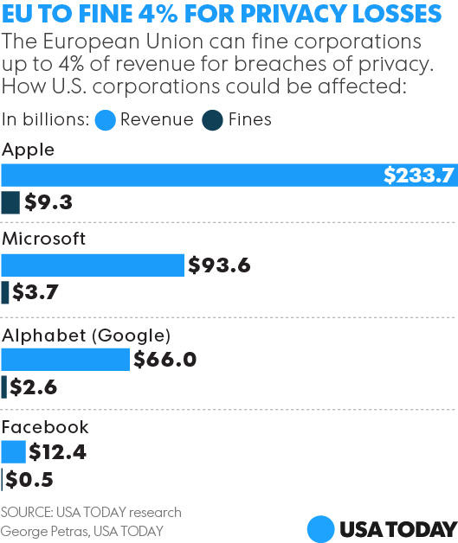

Slide 27
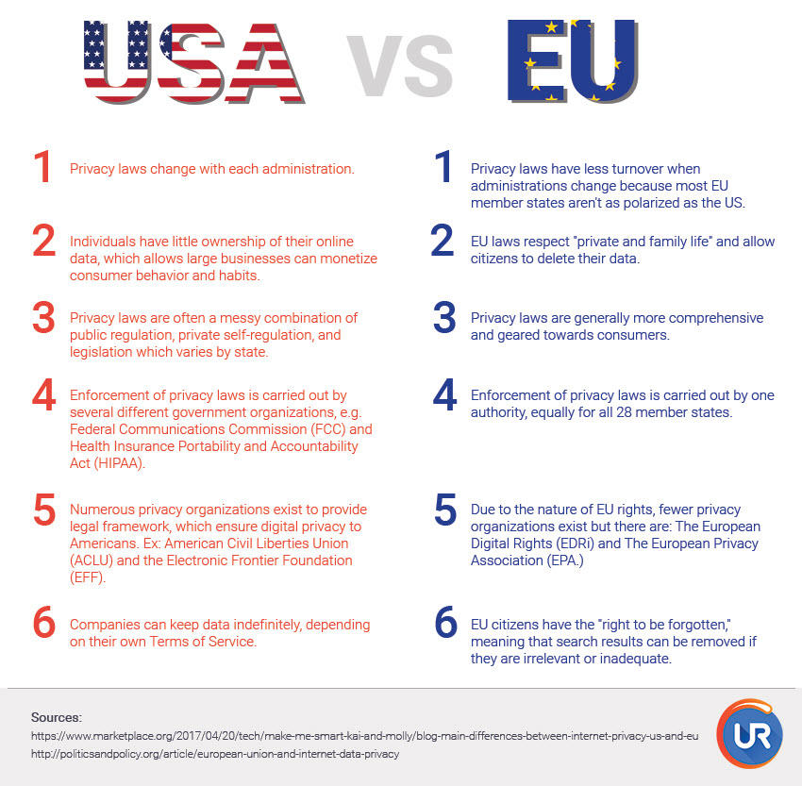

Slide 28
Most government agencies invest very little to ensure that fairness and due process protections remain in place when switching from human-driven decisions to algorithmically-driven ones.

Slide 29
Ethics of Algorithms in France
Setup: A case where Google was sued for defamation as a result of the autocomplete suggestions generated during a partial search.
Ruling: Algorithms are by definition neutral and cannot exhibit any sense of intention, and therefore Google can’t be held responsible for the results of automatic algorithm-driven suggestions.

Slide 30
Algorithms and Freedom of Information Act (FOIA)
Since 1967, the Freedom of Information Act (FOIA) has provided the public the right to request access to records from any federal agency. It is often described as the law that keeps citizens in the know about their government.
Many Issues Arise

Slide 31
Suppose we do require that the software be released? Can’t it just be obfuscated so that we can’t really tell what it’s doing, except as a black box?
Suppose we instead require that the algorithm be released. What if it’s a learning algorithm that was trained on some data? If we release the final trained model, that might tell us what the algorithm is doing, but not why.
Does it even make sense to release the training data? What happens if the algorithm is constantly learning (like an online learning algorithm)? Then would we need to timestamp the data so we can roll back to whichever version is under litigation?
But suppose the algorithm instead makes use of reinforcement learning, and adapts in response to its environment. How on earth can we capture the entire environment used to influence the algorithm?

Slide 32
Artificial Intelligence Initiative Act
This bill requires certain federal activities related to artificial intelligence, including implementation by the President of a National Artificial Intelligence Research and Development Initiative.
The initiative must invest in artificial intelligence research and development and support the development of an artificial intelligence science and technology workforce pipeline, among other activities.
The Office of Science and Technology Policy (OSTP) shall establish or designate
a National Artificial Intelligence Advisory Committee to advise the OSTP on matters related to the initiative;
a National Artificial Intelligence Coordination Office to provide technical and administrative support to the advisory committee and serve as the point of contact on federal artificial intelligence activities; and
an Interagency Committee on Artificial Intelligence to coordinate the artificial intelligence and technology research and education activities and programs of the federal agencies, among other activities.

Slide 33
The National Institute of Standards and Technology shall, among other things
carry out initiative activities, including by awarding contracts as necessary;
support the development of measurements and standards necessary to advance commercial development of artificial intelligence applications; and
establish collaborative ventures or consortia.
The National Science Foundation shall
implement a research and education program on artificial intelligence and engineering, and
award grants to establish up to five Multidisciplinary Centers for Artificial Intelligence Research and Education to conduct activities in support of the initiative.
The Department of Energy shall carry out an artificial intelligence research and development program.

Slide 34
Progress on Artificial Intelligence Initiative Act

